Slide 1

The Truth Behind the Rise in Police Shootings in the United States of America
By: Will Murray
Notes:
Please click through my slides in presentation mode because I added some animations to focus the audience’s attention on my story

Slide 2
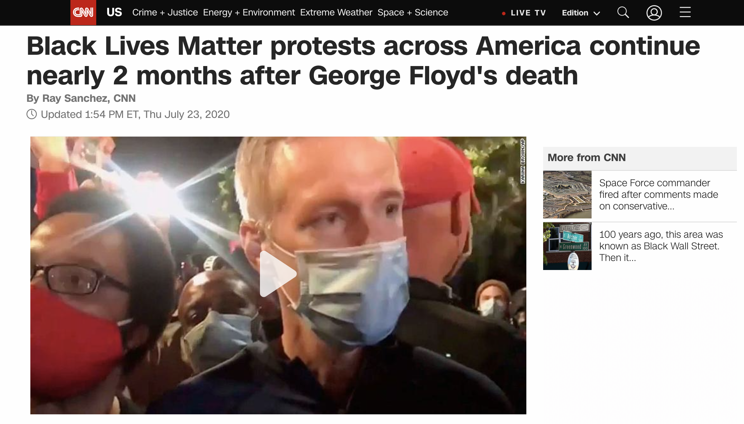
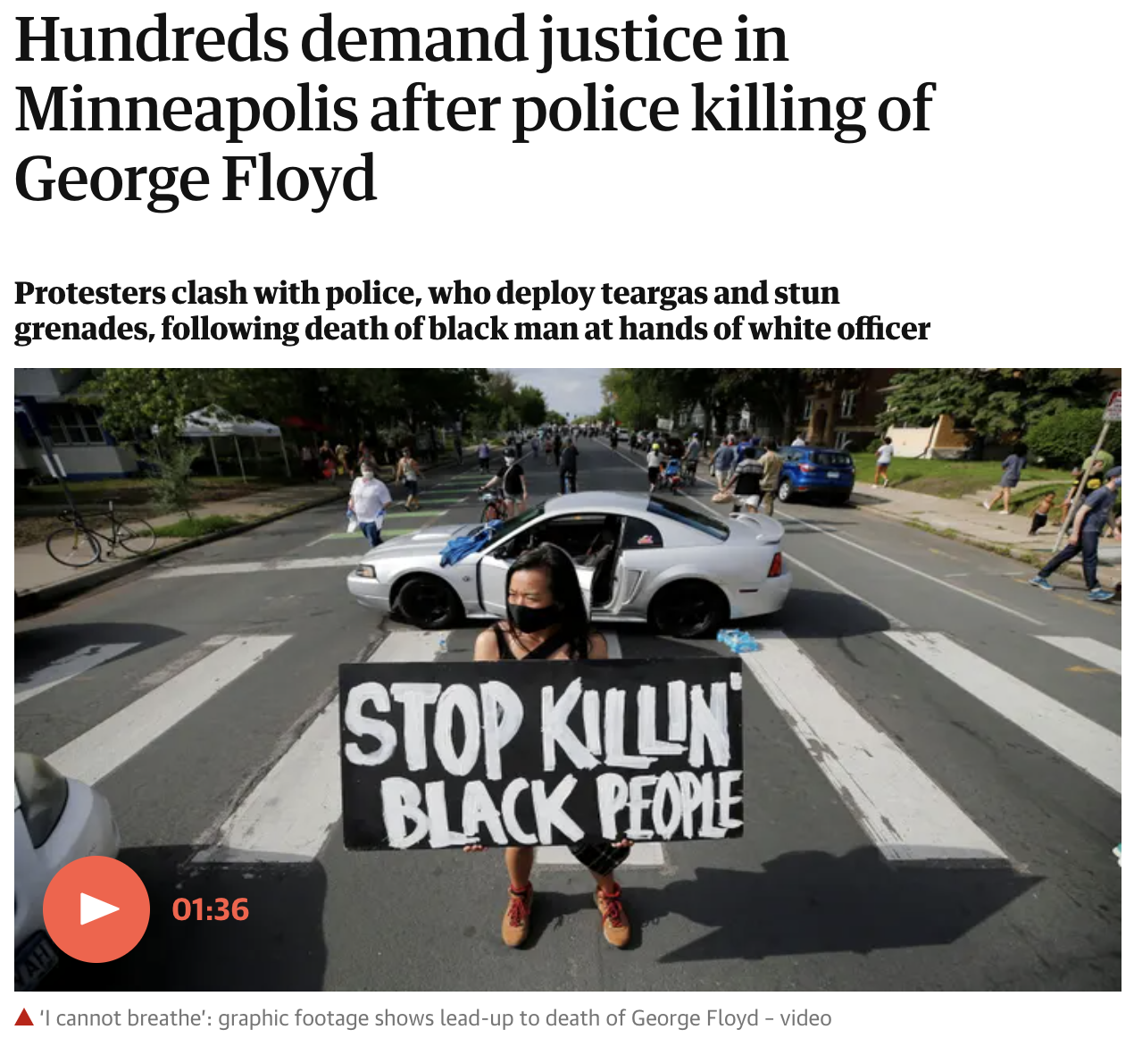
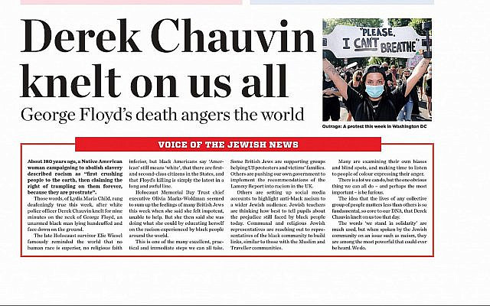
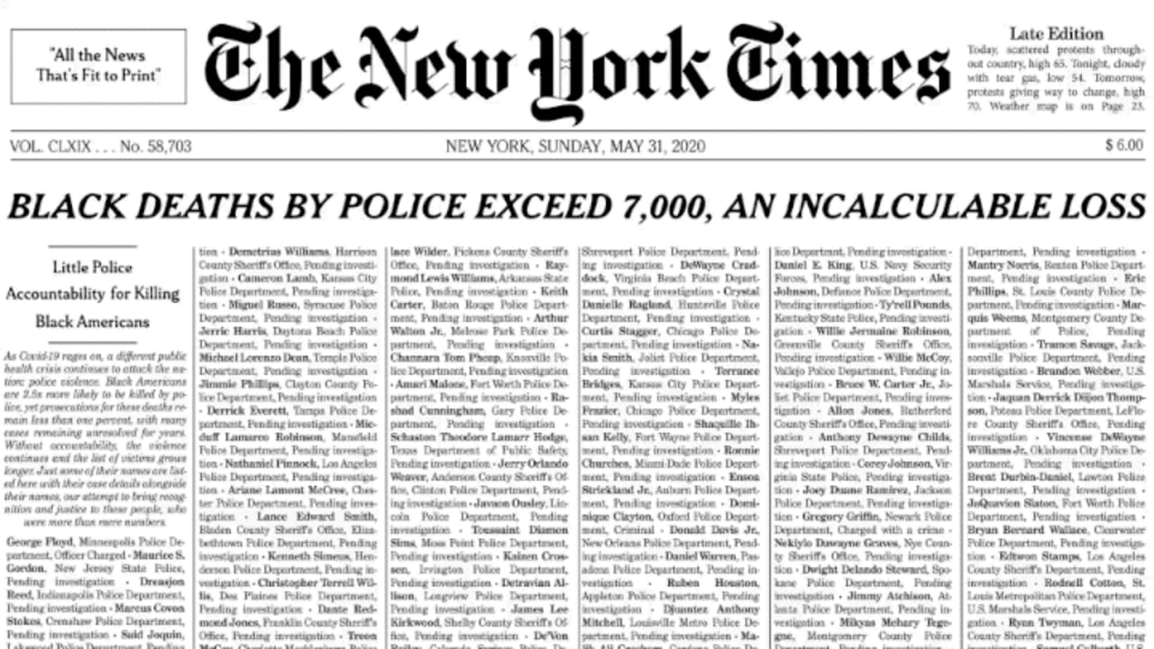
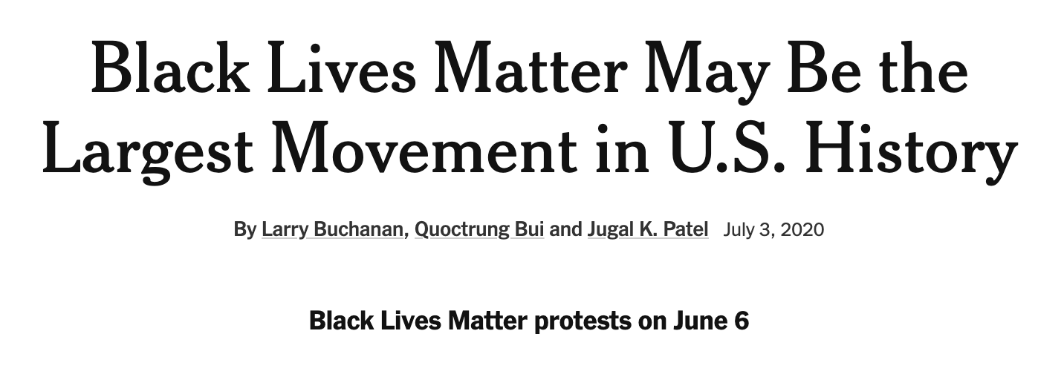
Introduction: What does the media say?
Sources: NY Times, CNN, Washington Post, Wall Street Journal
Notes:
- Here I would read the headlines, and then end with mentioning how the final headline is from the NY Times

Slide 3
Introduction: Statistics to provide context
Clearly, police shootings are an important topic to discuss. Many of the past years’ news headlines have been dominated by stories about the relationships between police brutality and racism, with many placing blame on the police institution
Fast facts based on the police shootings data set
50% of police shooting victims are white, yet over 75% of the US population is white
Over 25% of police shooting victims are black, yet only 13% of the US population is black
Less than 25% of victims exhibited signs of a mental illness prior to being killed
Only 5% of victims were tased prior to being shot
Over 70% of victims were armed with either a knife or a gun when they were killed
There are a ton more interesting statistics to be found, but the truly insightful stories come to light after analyzing the data relationships. Let’s dig deeper together to find the truth behind the numbers
Source: US Shootings Story, “shootings”, US Census Bureau
Notes:
I would essentially read through the slide, emphasizing how the first four facts are stories that are more pessimistic, but the final one is something that the media does not commonly address
I would mention how these statistics do not tell the full story
Then I would pivot and setup my more thorough analysis to come

Slide 4
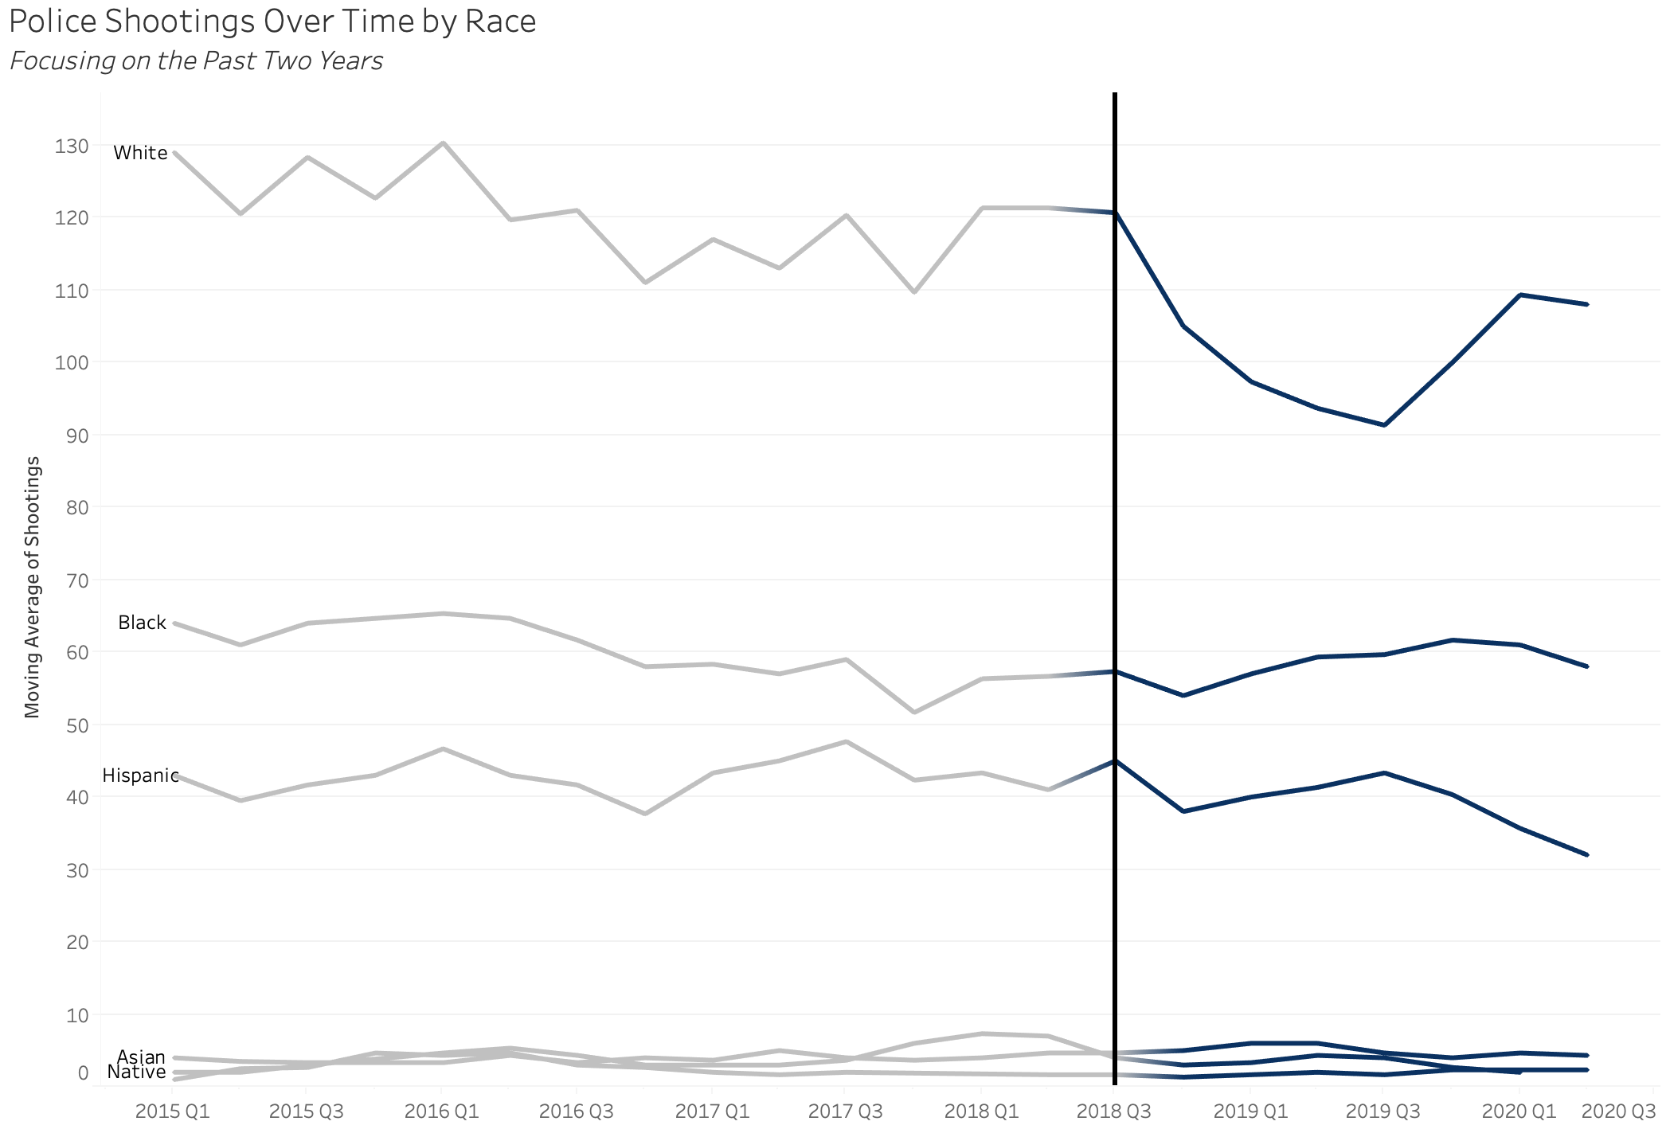
Overall police shootings have declined in recent years, but not for all races
From 2015 Q1 to 2020 Q1, police shootings saw an 11% decrease
This hopeful statistic is not shared by all races - shootings of white individuals declined by a notable margin, yet the number of shootings of minorities has hardly changed in recent years
In the past two years, the moving average of the number of shootings has even increased slightly for black individuals
Asian, Native, and Other races make up very few of the total shootings
Source: US Shootings Story, “shootings”
Notes:
I would start with talking about how there is an overall decrease in police shootings of around 10%, and how there does not appear to much of a trend from 2015 Q1 to 2018 Q1 in this line graph
Next I would unveil the rest of the line graph, which shows how white shootings are going down significantly overall, yet the other races are still hardly seeing a change over these past two years
Then I would point out the line for black individuals, seeing as this is commonly the main focus of police brutality discussions
I would also point out that the Asian and Native lines are low due to their significantly lower percentage of total population
Finally, I would mention that whether or not these differences are as dramatic as the media portrays them to be is another question

Slide 5
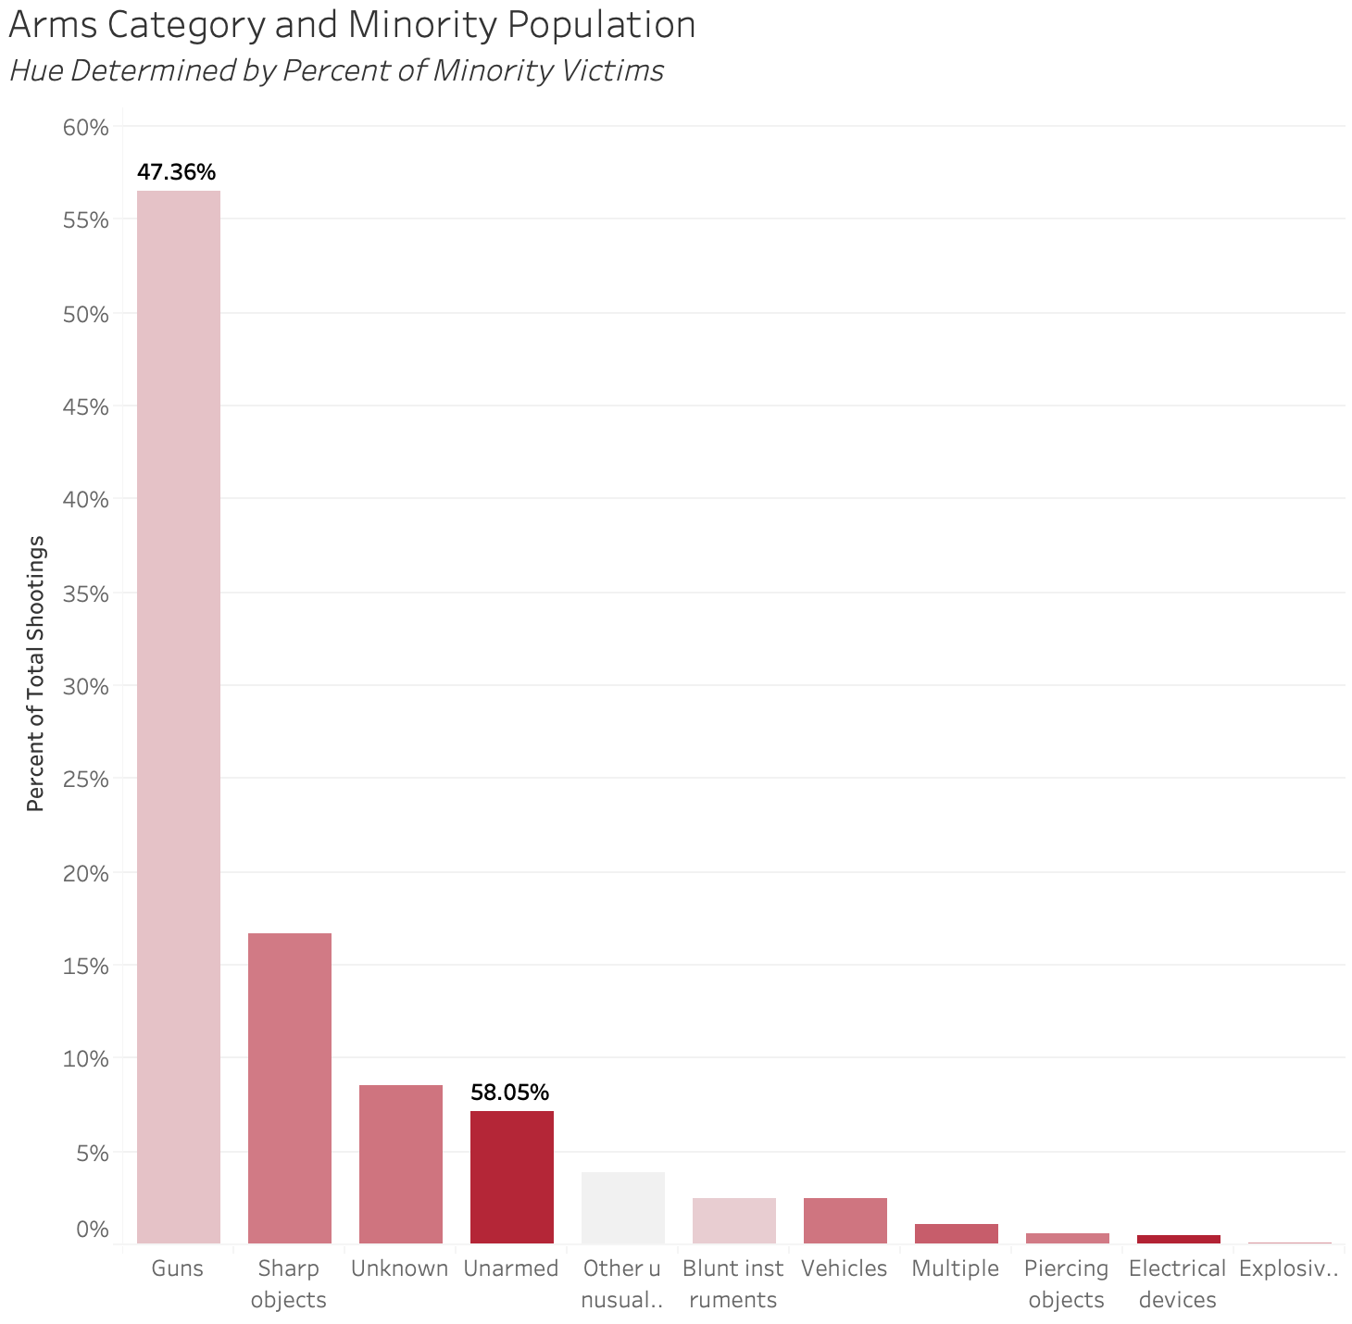
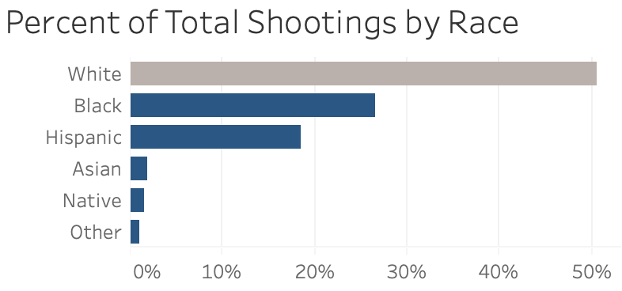
Unarmed minority individuals are being disproportionately killed
Minority races are being killed while unarmed at a disproportionate rate – certainly a concerning statistic
In this data set, minorities make up a little less than 50% of victims, yet 58% of unarmed victims are minorities
On the flip side, only 47% of victims with a gun were minorities
These numbers suggest minorities are more likely to be killed by police even if they pose less of a threat
Source: US Shootings Story, “shootings”
Notes:
Here I would start with the first statistic in the text box, pointing to bar graph on the right for support and focusing on the unarmed section
I would then read through the rest of my main points and again supporting them with my bar graph
Next, I would point out the bottom bar graph in reference to my intro slide which discussed how the percentage of police shootings by race are not spread out in the same way the US population is. This pertains to my bar graph on the right and the discussion of how minorities are being killed while unarmed so much more than you would expect purely based off of the US population of minorities

Slide 6
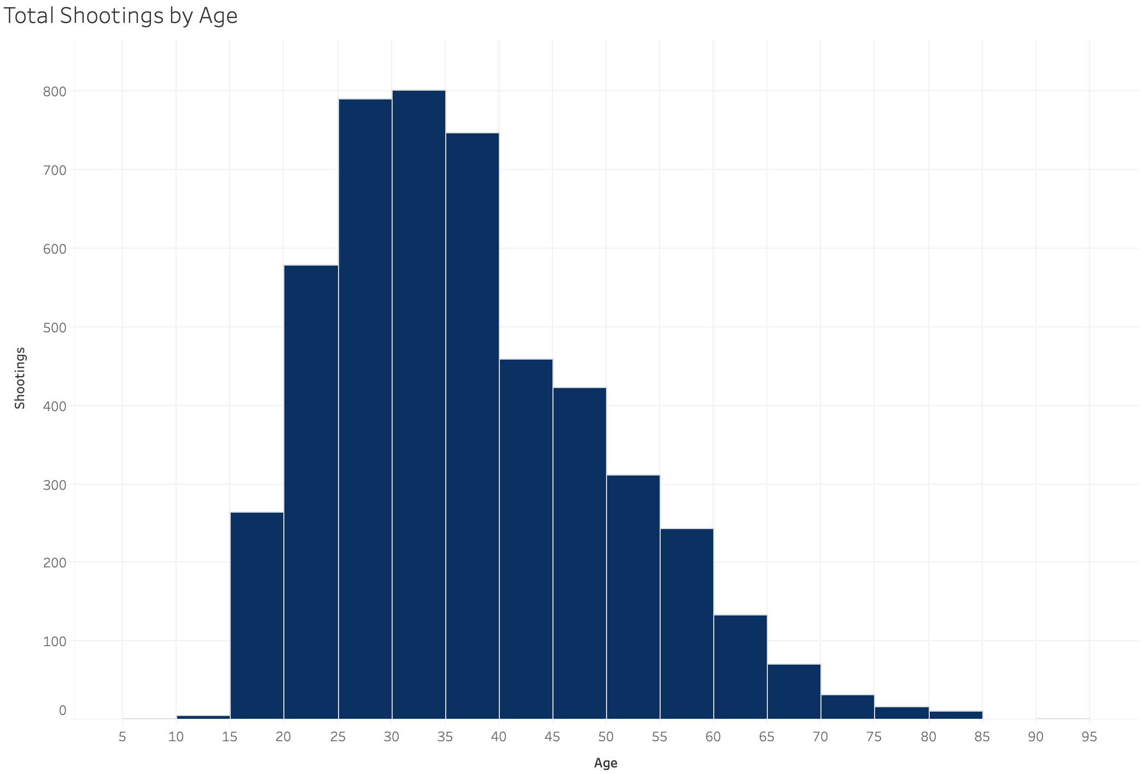
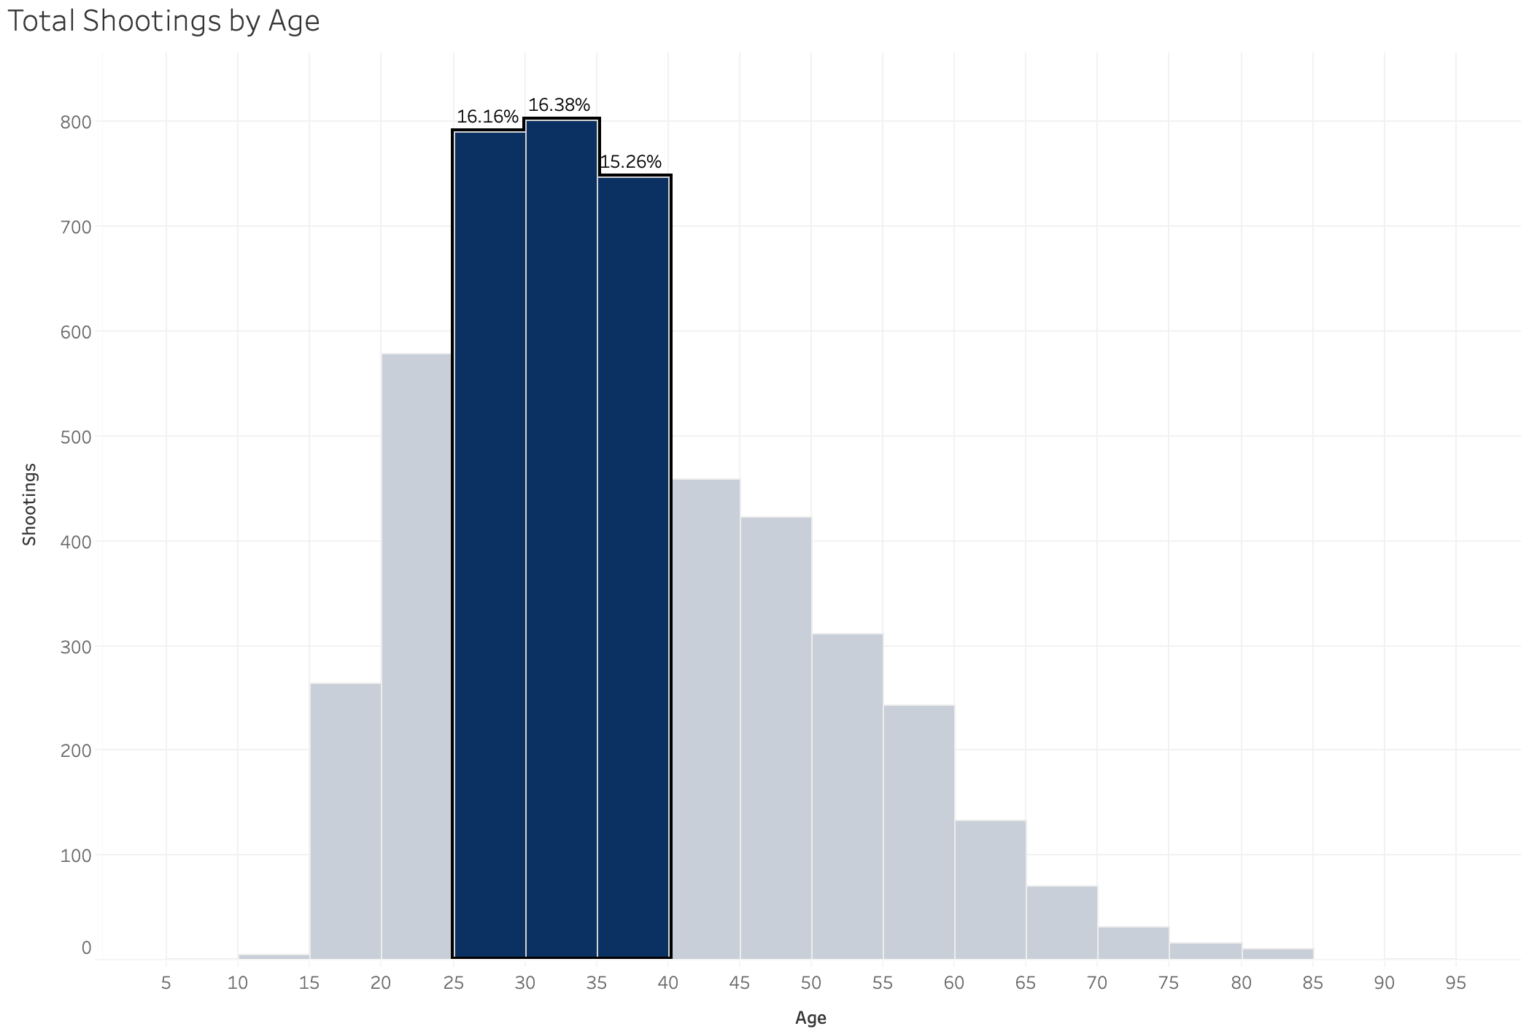
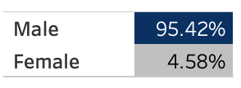
Unsurprisingly, physically threatening individuals are most likely to be killed
The clearest connection seems to be between a victim’s physical threat to a police officer and their likelihood to be killed
Young adults to middle aged men comprise by far the greatest portion of shooting victims – nearly 50% of victims were men between ages 25 and 40
65% of shootings had a threat level of “attack” with the other 35% being either “other” or “undetermined”
The self defense aspect of police shootings is rarely addressed in today’s media
Percent of Total Shootings by Gender
Source: US Shootings Story, “shootings”
Notes:
I would start by introducing and explaining my histogram, and by mentioning that this is where this presentation transitions into stories that are not commonly shown in the media
I would then focus in on the middle section and the percent of total shootings by gender (using the animation) to better display my story of the connection between physical threat and the likelihood of being killed
Next, I would talk through my statistics regarding threat levels, and then ending with how the media does not often mention the self defense aspect of nearly all police shootings

Slide 7
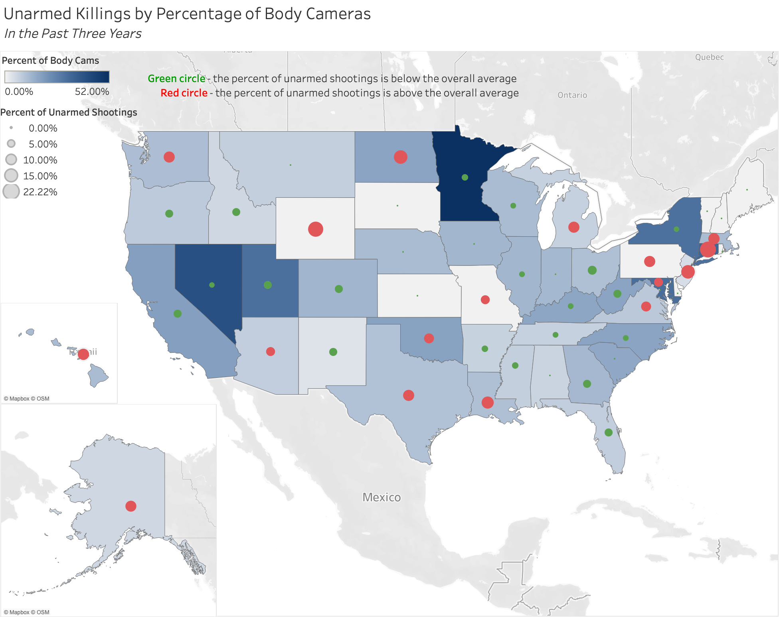
Hopeful avenues and next steps for addressing the rise in police shootings
Almost 90% of shootings do not have body cam footage, yet roughly half of police departments use body cameras
Though not a perfect relationship, in recent years it appears that states with greater body camera usage have less unarmed shootings
This presents a concrete avenue for forward progress – increasing the usage of body cameras could lower the number of unarmed shootings, thereby lowering the number of minority shootings
Body cameras provide accountability and the opportunity for the public to see the circumstances that led to an officer’s decision to shoot
Source: US Shootings Story, “shootings”, Government Technology
Notes:
To close out my presentation I would mention how I found some actionable next steps for addressing the problems that I pointed out
I would explain the map so that the audience can easily understand what all the different aspects mean
I would then transition into the statistics on the left, pointing out how concerning the first one is and also conceding that this is not a perfect correlation
I would relate my point about lowering the number of minority shootings back to my earlier slide that discussed how police are disproportionately killing unarmed minorities
To conclude, I would point out the hopeful benefits of increased body camera usage, specifically how they would allow the public to create a more informed opinion on the police institution as a whole

